Slide 1


Pneumonia Detection
IBM Advanced Data Science Capstone
March 15, 2021
Salvatore Salpietro

Slide 2
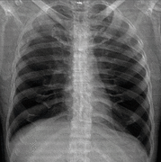

Summary
Part 1 – Stakeholder presentation
Background
Use case
Data set
Solution
Part 2 – Data science presentation
Architectural choices
Data set description and preparation
Model selection, architecture, and performance

Slide 3

Part 1 Stakeholder Presentation

Slide 4
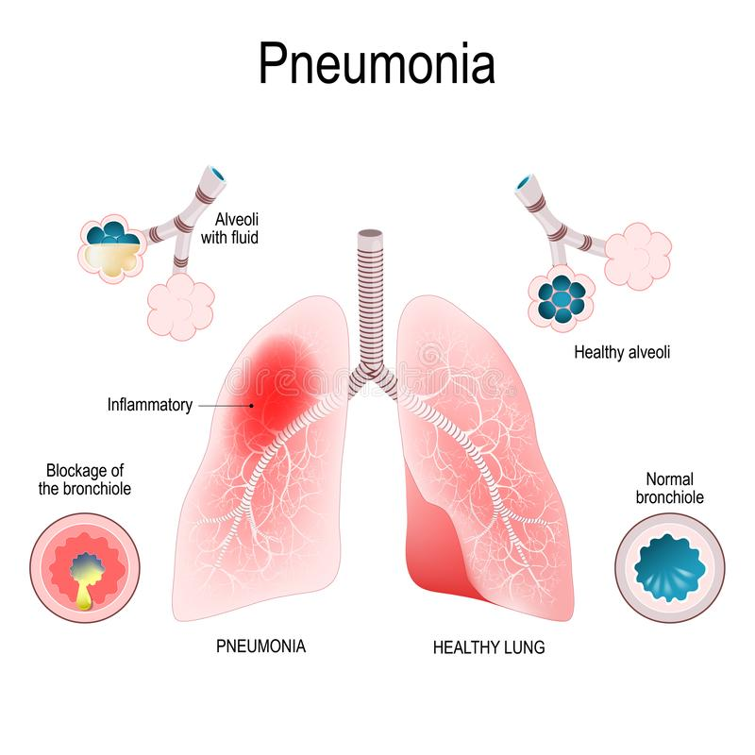
Background
Pneumonia is an inflammatory lung disease that affects the small air sacs called alveoli.
It is caused by bacterial, viral or fungal infections.
Symptoms include
- cough
- chest pain
- fever
- difficulty breathing.

Slide 5
Background
A
There are three main anatomical classification of pneumonia by location in the lungs, these are,
A - Lobar pneumonia
- involves one or more lobes, or section, of a lung
B - Bronchial pneumonia
- affects the lungs in patches around the tubes (bronchi or bronchioles)
C - Interstitial pneumonia
- involves the areas in between the alveoli
B
C

Slide 6
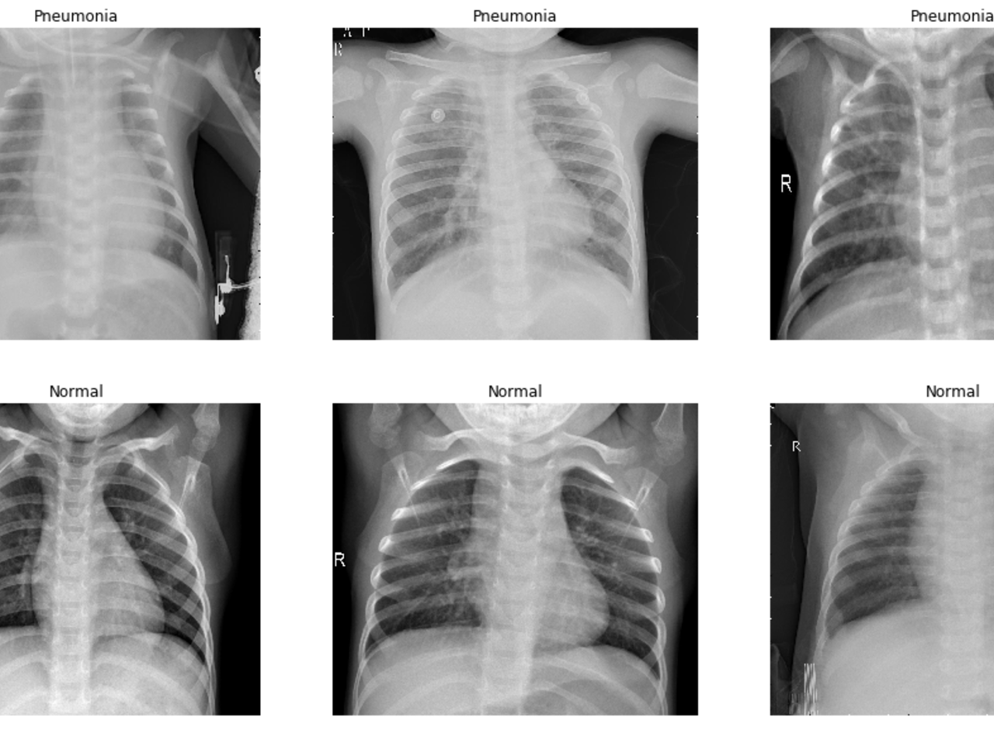
Background
Diagnosis
Doctors rely on a combination of methods including observing physical signs, blood tests, and often a chest X-ray.
Chest X-Ray
Using x-ray images doctors distinguish between diseased lung vs healthy lung as follows
White shadows represent areas where the beam is blocked by more dense tissues like bone.
Darker shadows represent areas where the x-ray beam penetrates more easily such as in air filled tissues like the lungs.

Slide 7
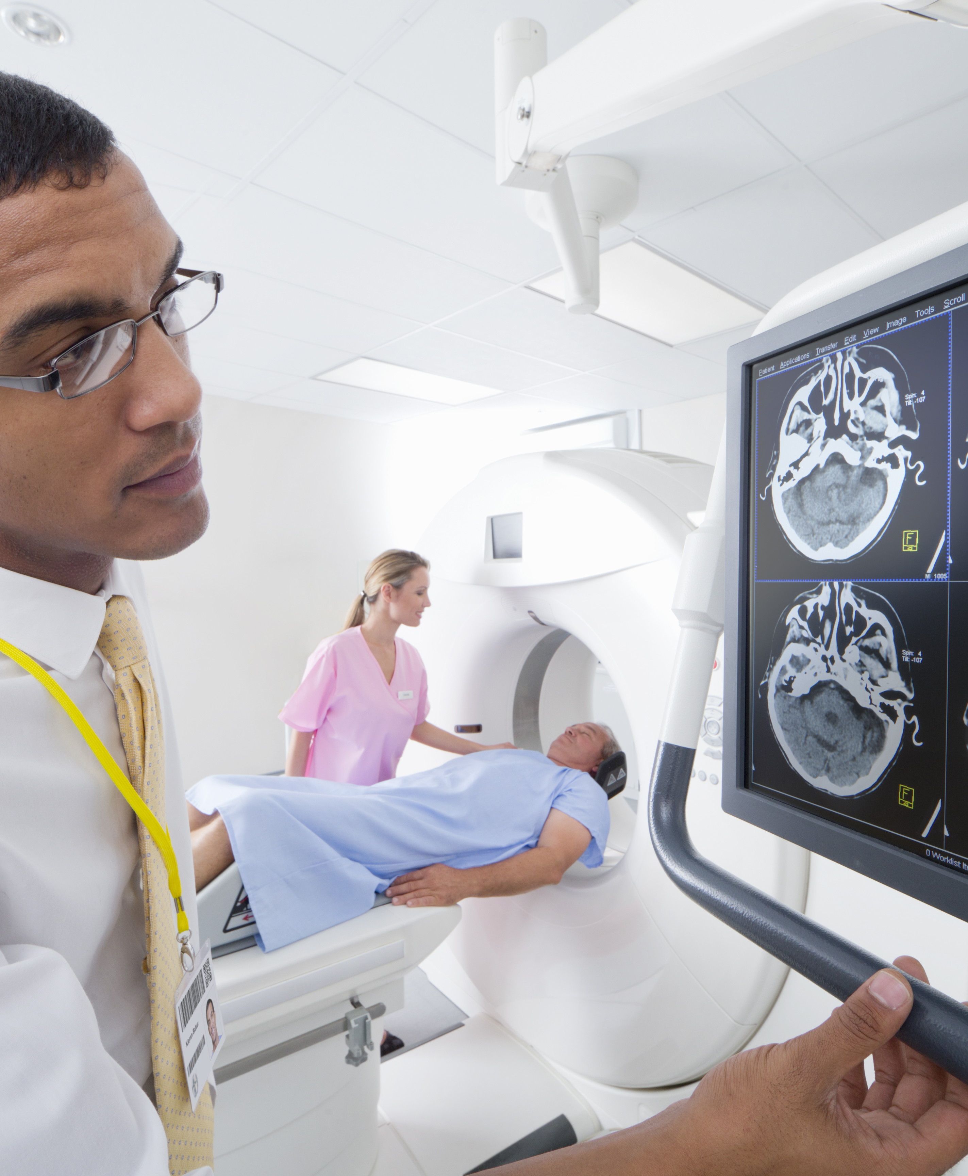
Use Case
In this project we will attempt to create a machine learning model that will effectively automate what the doctor is doing when they screen a patient for pneumonia using x-ray images.
By training the model on a set of healthy and diseased lung X-ray images, it will be able to distinguish between the two types.

Slide 8
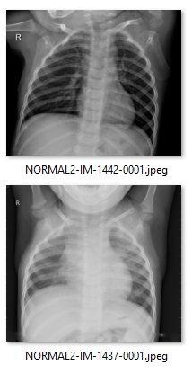
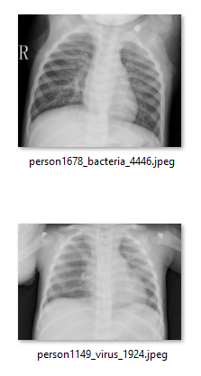
Dataset
Normal images
Pneumonia images
Source: Mendeley Data
Mendeley Data - Large Dataset of Labeled Optical Coherence Tomography (OCT) and Chest X-Ray Images
Dataset:
7197 .jpeg image files of chest X-rays
634 test images
5232 training images
Images are subdivided into two categories
Normal
Pneumonia (virus or bacteria)
Data source citation:
Kermany, Daniel; Zhang, Kang; Goldbaum, Michael (2018), “Large Dataset of Labeled Optical Coherence Tomography (OCT) and Chest X-Ray Images”, Mendeley Data, V3, doi: 10.17632/rscbjbr9sj.3

Slide 9



Solution
Internet
TensorFlow Deep learning model
Image classifier on two categories (normal / pneumonia)
Rest API
Model is saved and exposed using a Flask Web API project and packaged up in a Docker container
Deployable on any machine or cloud service for example IBM Code Engine
Rest API endpoint accepts an X-Ray image and returns the classification (normal or pneumonia) with a probability score.
IBM Cloud
REST API
Client
ML Model

Slide 10
Part 2 Data Science Presentation
Let’s dive in

Slide 11




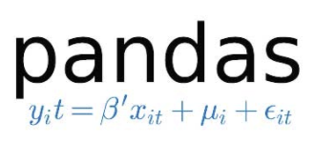





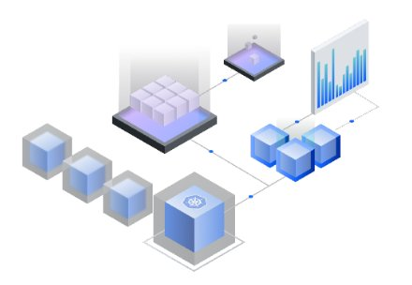
Architectural Choices
Development Environment
IBM Watson Studio, Jupyter Notebook
Data Preparation Exploration
IBM Object Storage
Pandas, scikit-image
Model Training / Evaluation
TensorFlow, scikit-learn
Data Product
Flask Rest API, Docker
IBM Code Engine
IBM Code Engine

Slide 12
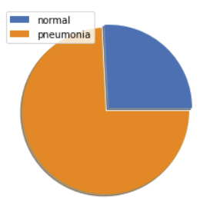
Data Quality Assessment
File Types (.jpeg)
Quantity
Total # of images - 7197
Distribution between training and testing
Train / Test split is about 89.34 / 10.65
Distribution between different classes

Slide 13
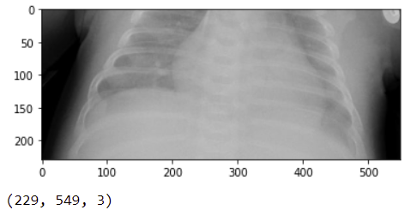
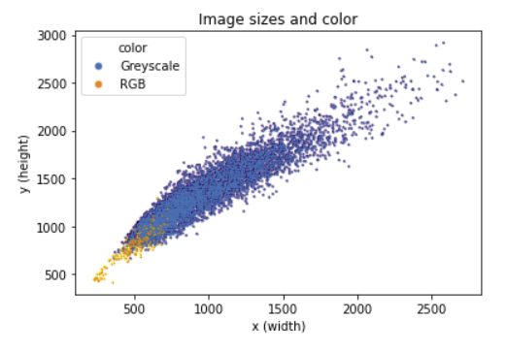
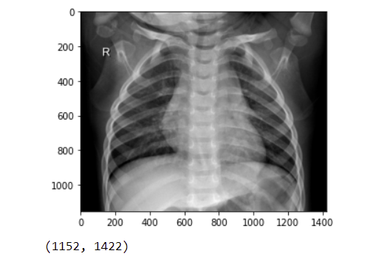
Data Quality Assessment
Shape and color space of images

Slide 14
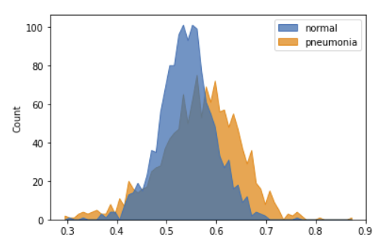
Data Quality Assessment
Histograms
Normal images are shifted toward black intensity (0.0)
Pneumonia images are shifted toward white intensity (1.0)

Slide 15
Data Preprocessing
Discard outliers (126 images) of poor aspect ratio
Redistribute data closer to 85 / 15 split
Add validation set
Convert all images to grayscale
Normalize (convert pixel values to between 0 and 1)
Resize all images to height 128 and width 128

Slide 16
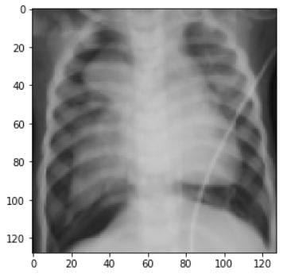
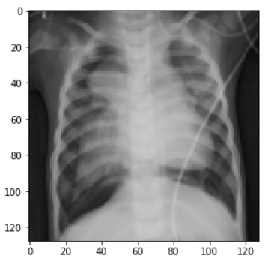
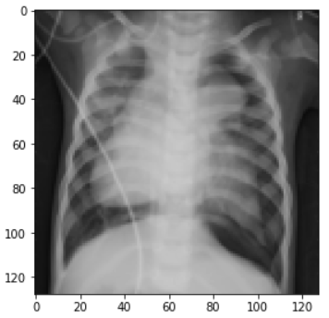
Image augmentation
Image augmentation to increase data size and variation
Flip, zoom
Zoom
Flip

Slide 17
Feature Engineering
Machine Learning Models
Principal Component Analysis (PCA)
Deep Learning Models
Convolution Layers

Slide 18
Model Performance Indicators
AUC
Precision
Recall
F1 Score

Slide 19
Model Selection
7 models in total
Evaluated 4 different machine learning algorithms
Naïve Bayes
Random Forest
Decision Tree
Support Vector Machine (SVM)
Evaluated deep learning algorithm
3 different convolutional neural network architectures

Slide 20
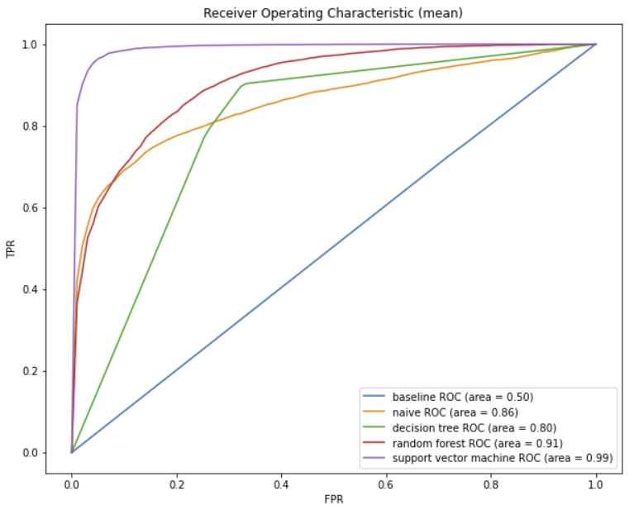
Model Selection
Model selection results for the 4 machine learning algorithms
Support Vector Machine algorithm performed the best

Slide 21
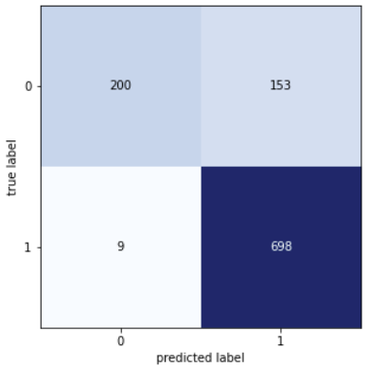
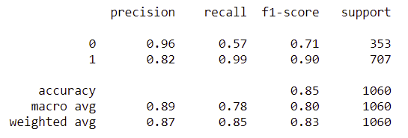
Model Selection
Support Vector Machine
Hyperparameter tuning (GridSearchCV) before training final model
C = 10
Kernel = rbf
Final model results on Test Set

Slide 22
Model Selection
Results for the 3 CNN architectures
Decided to choose CNN 2
CNN-2 does a slightly better job of classifying both classes particularly the positive class as shown by the higher AUC value
final model for CNN-2 did better on the test set
Model | AUC | Precision | Recall | F1
CNN 0 (small) | 0.9980 | 0.9953 | 0.9913 | 0.9933
CNN 1 (medium) | 0.9976 | 0.9943 | 0.9758 | 0.9845
CNN 2 (large) | 0.9994 | 0.9956 | 0.9907 | 0.9931

Slide 23
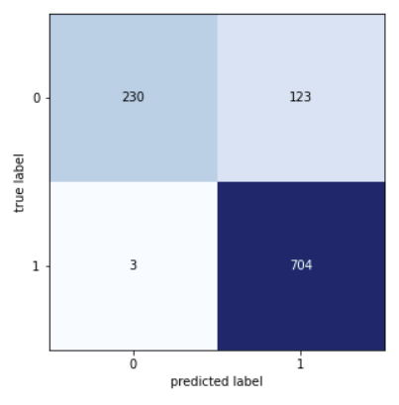
Selected Model Performance
Best deep neural network model (CNN 2) performance on the test set compared with the best machine learning model (SVM)
SVM
CNN 2
CNN 2
Winner, best overall
F1 0.83
Precision 0.87
Recall 0.85
F1 0.87
Precision 0.90
Recall 0.88

Slide 24
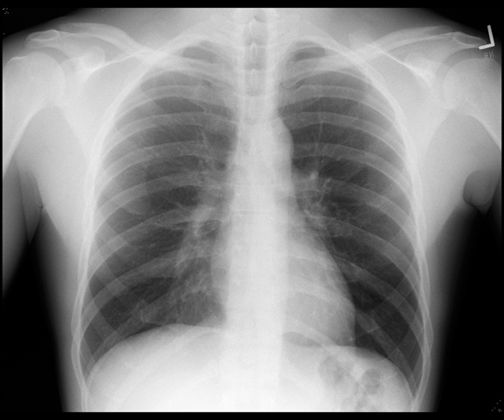
Model Architecture – CNN 2
max pool
64x64x32
max pool
32x32x64
max pool
16x16x64
max pool
8x8x128
max pool
4x4x256
dense
1x1x256
dense
sigmoid
Epochs: 50
Batch Size: 64
Optimizer: Adam
Learning Rate: Default (0.001)
Regularization: L2 = 0.007
Dropout: 0.1 0.3 and 0.5
input
128x128x1
conv
128x128x32
conv
64x64x64
conv
32x32x64
conv
16x16x128
conv
8x8x256

Slide 25
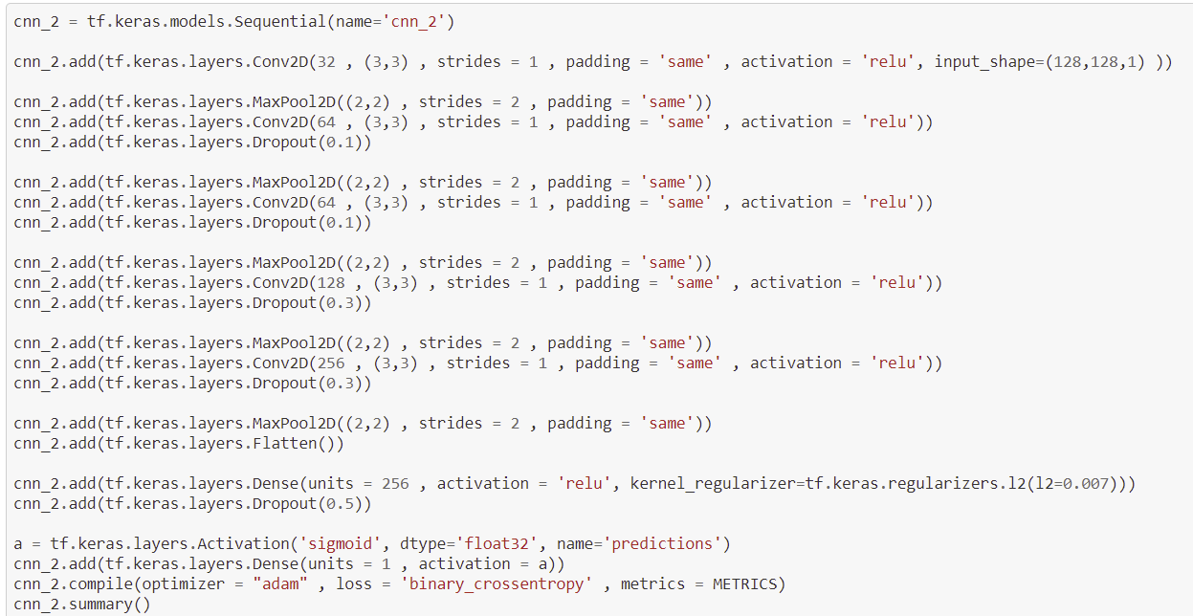
Model Architecture – CNN 2

Slide 26
Conclusion
Successfully created a classifier that can distinguish between x-ray images of normal lung and lung with pneumonia
Data product exposes the classifier using a REST API
Support vector machine performed comparable to deep neural network
Obtained slightly better results by using a Convolutional Neural Network
Classifier does not perform too well on normal images due to small data set size
To get better performance on normal images, we should obtain more labelled data for the normal class

Slide 27
Conclusion
Thank you for watching!

